Slide 1
Analyzing The Standard metagame in MTG
Connor Nelson

Slide 2
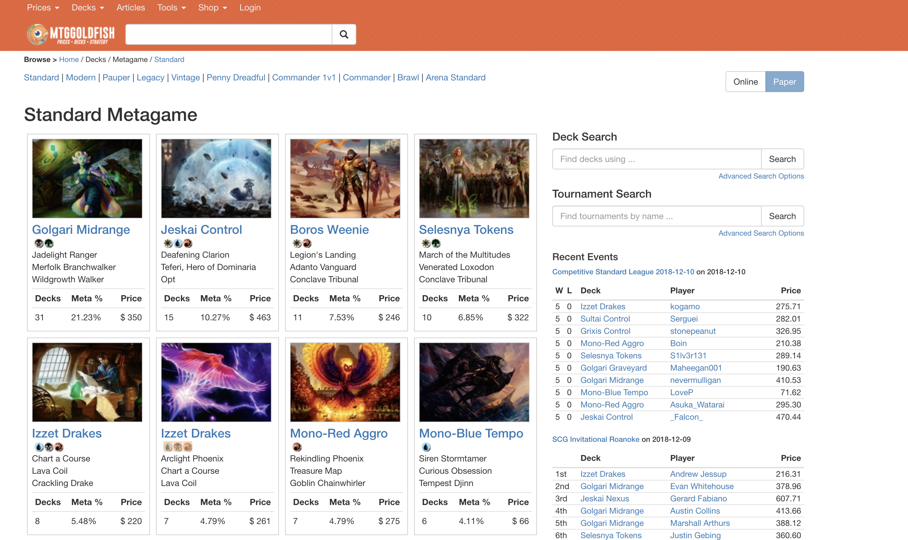

Where was my Data From?
Scraping MTG Goldfish and Wizards of the Coast’s current rulebook
MTG Card Publicly Accessible API

Slide 3
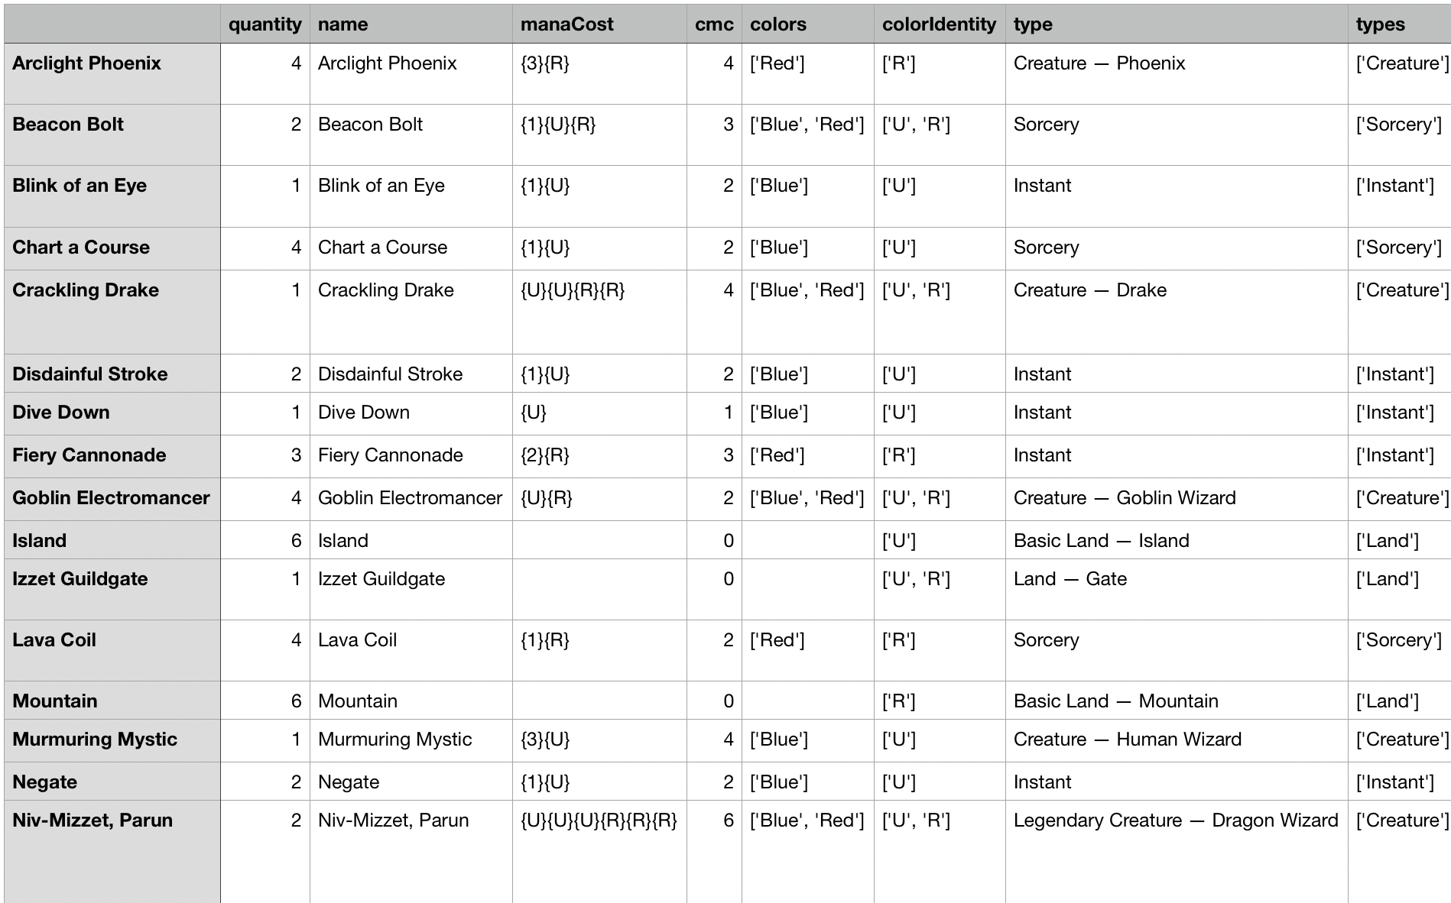
What did I do with IT?
Combined it all together into a big CSV
Sorted it by Set
Totaled the number of cards used in each set by weighing each card differently based on the average win rate of the decks it was in
Then plotted the data in order to show how each set contributed to the current metagame

Slide 4
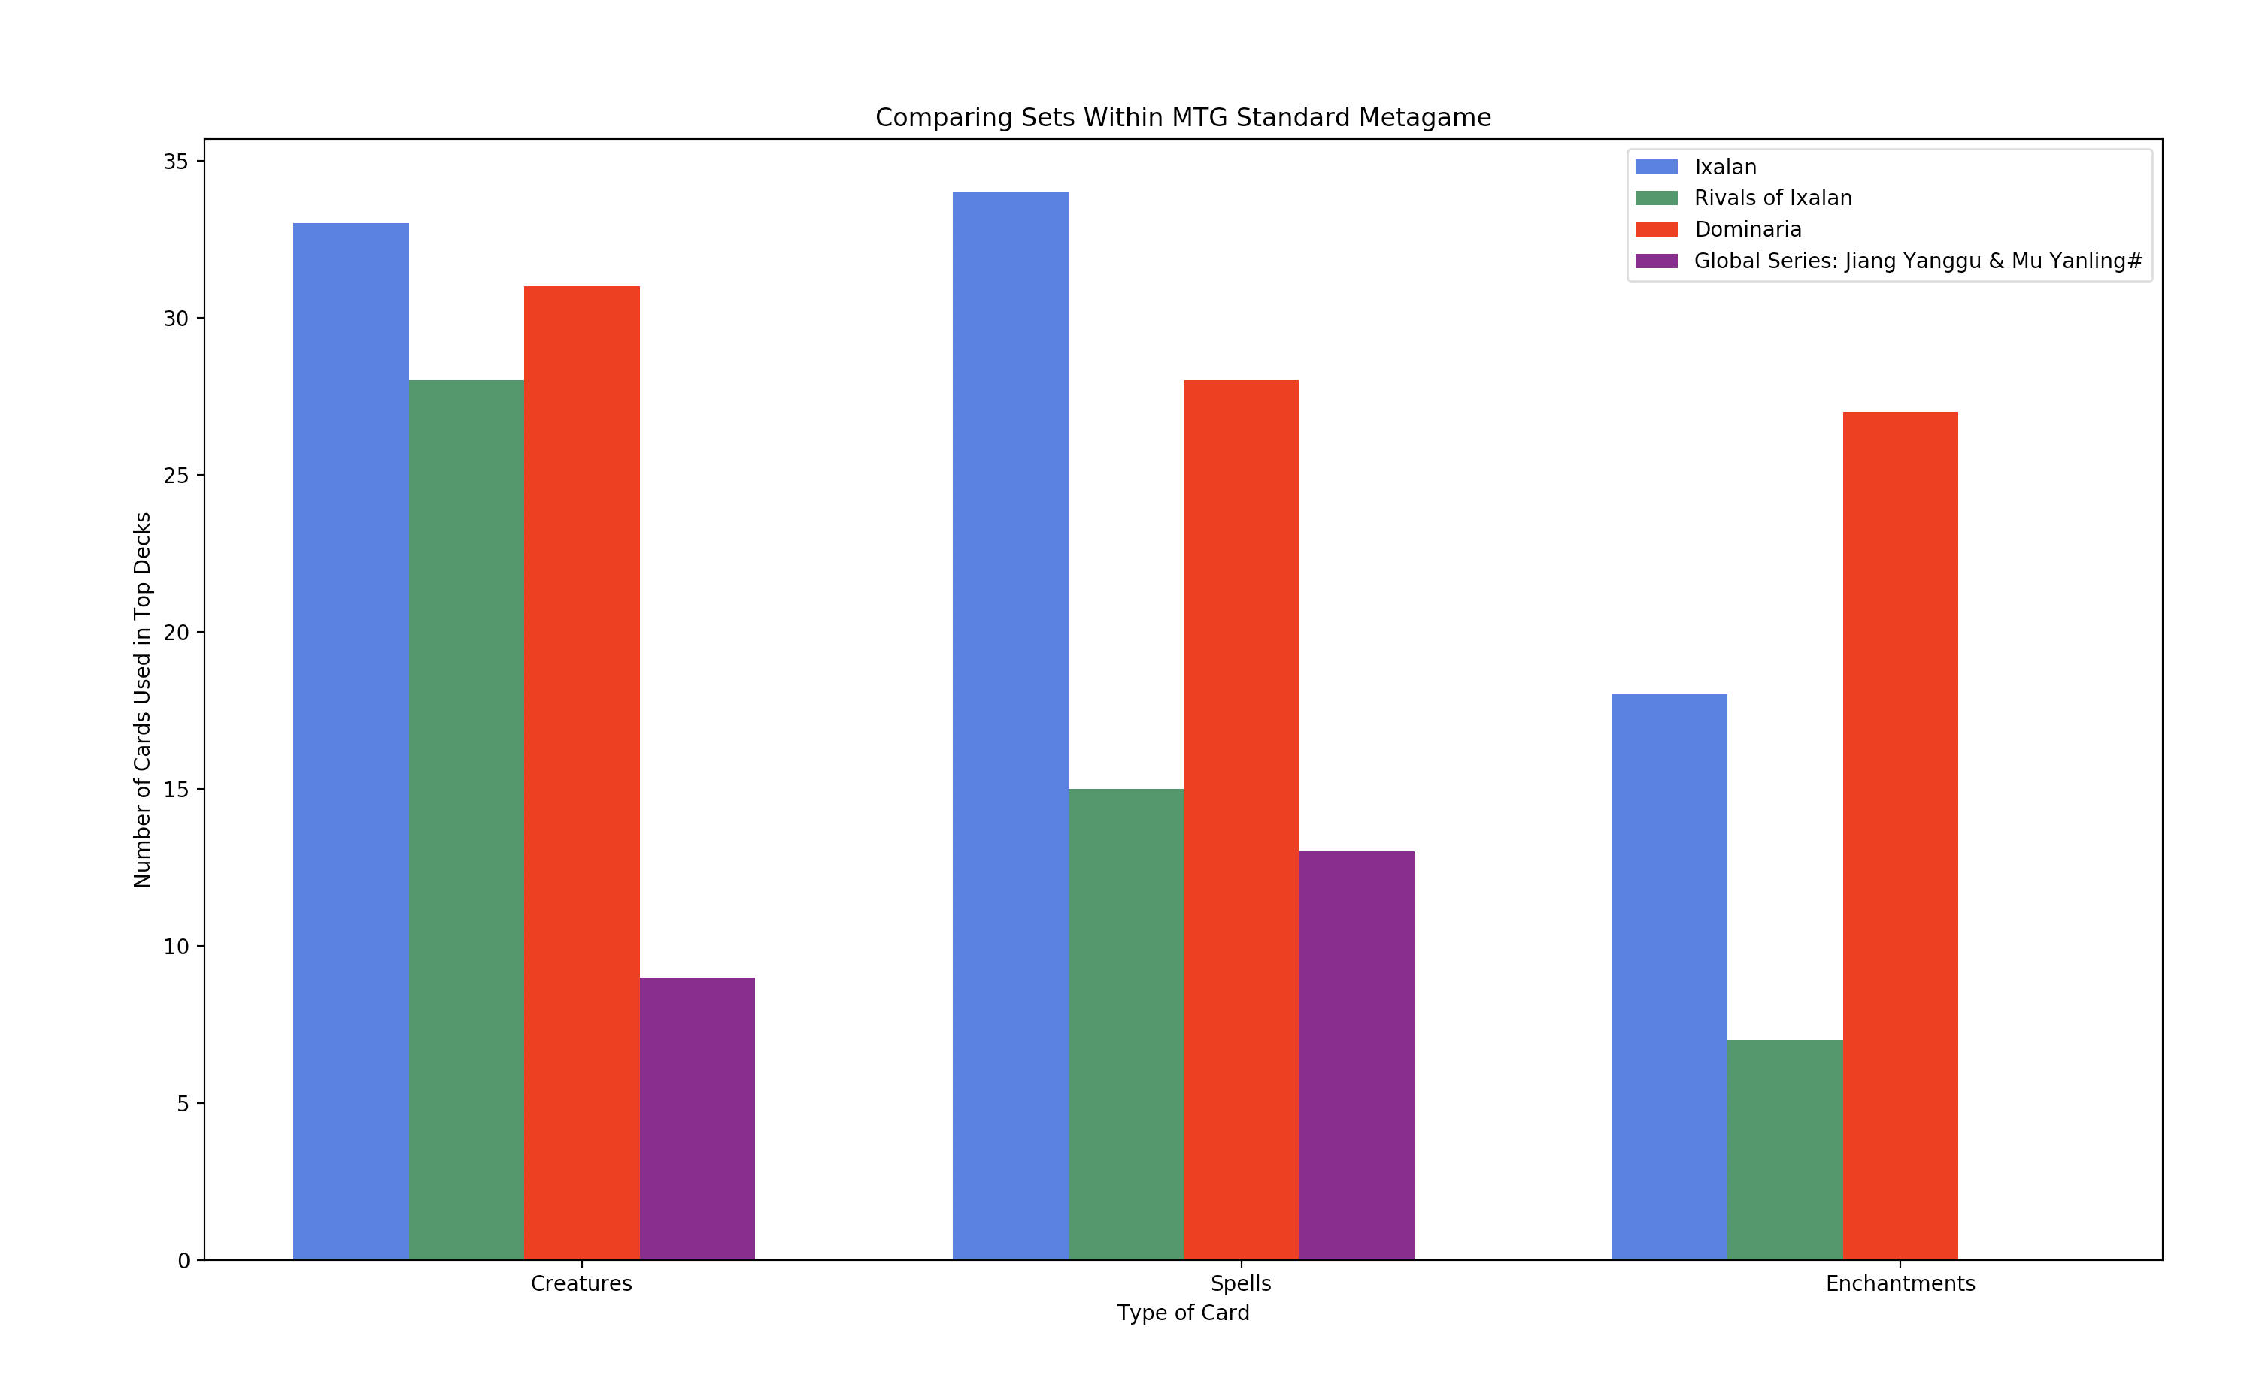
End Result

Slide 5
Challenges
Making the program “future-proof”
I wanted to make a program that I could boot up in a year and it would, as long as none of the websites or APIs that I was using changed, give me exactly the same output with no changes.
This was extremely difficult and required some dictionary usage that I was not familiar with
Matplotlib
Using this and getting the graph to show up with no overlap and correctly was more difficult than it should have been

